Slide 1
Linear and Quadratic Programming
Optimization Problem Formulation
Your need 8th std to 12 std mathematics

Slide 2
Two types of optimization problems
that we will deal in first semester
1. Unconstrained - Mainly Newton and Quasi Newton methods
2. Constrained: Convex objective function and convex constraints
LP, QP,SDP etc

Slide 3
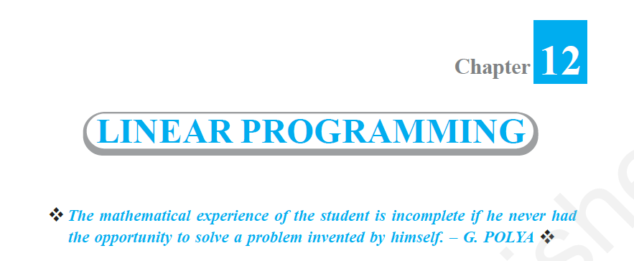
Optimization
Solution by CVX
Two variable Linear programming formulation
Download the +2 chapter on LP from here
https://ncert.nic.in/textbook/pdf/lemh206.pdf

Slide 4
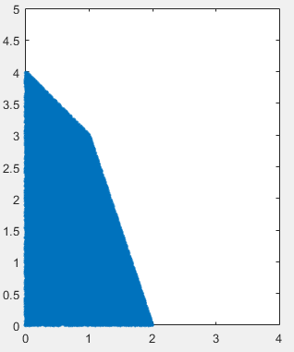

Plotting the 2D feasible region
Code is not generic.
Depending on the y -intercept
of constraints, you need to change
Range of x and y in the code
$$\begin{matrix}x≥0; \\ y≥0.\end{matrix}$$
N=200000; % number of (x,y) points in domain
x = rand(N,1)*6;
y = rand(N,1)*6;
f1 = x+y-4; % An array of N fn values in domain
ind1 = (f1<0); % An N_array of logical 0s and 1s
f2 = 3*x+y-6; % An array of N fn values in domain
ind2 = (f2<0); % An N_array of logical 0s and 1s
ind3=and(ind1,ind2); % An N_array of logical 0s and 1s
a = [x(ind3),y(ind3)];% points which are in feasible region
figure
plot(a(:,1),a(:,2),'.','MarkerSize',10);
axis equal
xlim([0 6])
ylim([0 6])

Slide 5
Inequality
How do we check whether point (1,2)
Is below the line or above line

Slide 6
40=4x₁+10x₂
40=4x₁+10x₂
3
x₁>0
x₂>0
4

Slide 7
Methods for Solving LP
Simplex- The classical method
ADMM-Most Modern Method
IP-Interior Point method.
(An Indian mathematician ‘Narendra Karmarkar’ pioneered research in this area)
We learn only this. The method can solve a wide variety of problems

Slide 8
Solve Example problems from +2
Using CVX

Slide 9
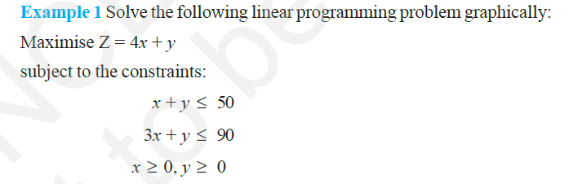
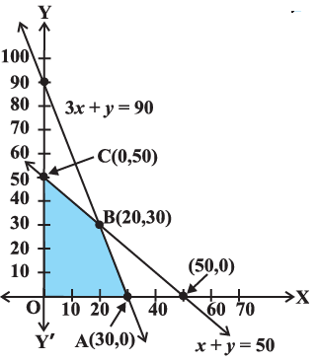
Feasible Region
Using CVX
% problem 1
cvx_begin quiet
variables x y
maximize 4*x+y
subject to
x+y<=50
3*x+y<=90
x>=0
y>=0
cvx_end
sprintf('x=%0.2f y=%0.2f maxvalue=%0.2f',x,y,4*x+y)

Slide 10
cvx_begin quiet
variables x y
minimize 200*x+500*y
subject to
x+2*y>=10
3*x+4*y<=24
x>=0
y>=0
cvx_end
sprintf('x=%0.2f y=%0.2f minvalue=%0.2f',x,y,200*x+500*y)
Using CVX

Slide 11
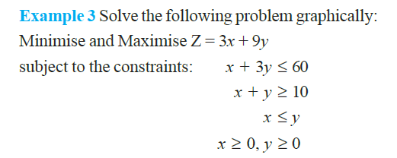
'x=8.23 y=17.26 maxvalue=180.00'
cvx_begin quiet
variables x y
maximize 3*x+9*y
subject to
x+3*y<=60
x+y>=10
x<=y
x>=0
y>=0
cvx_end
sprintf('x=%0.2f y=%0.2f maxvalue=%0.2f',x,y,3*x+9*y)
Using CVX

Slide 13
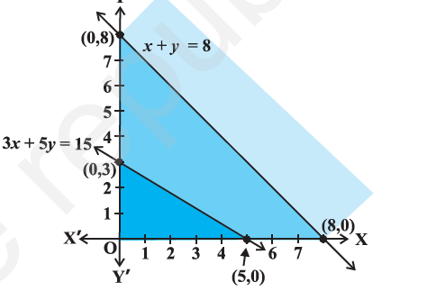

Slide 14
Converting inequalities in LP into
Equalities
1.Surplus and slack variables
2. Expressing the problem compactly
Using matrices and vectors

Slide 16
x = 30.00
0.00
20.00
0.00
Z = 120.00
% problem 1
A=[1 1 1 0; 3 1 0 1]; b=[50;90];
c=[4 1 0 0];
cvx_begin quiet
variables x(4)
maximize c*x
subject to
A*x==b;
x>=0
cvx_end
% display
x
Z=c*x
% problem 1
cvx_begin quiet
variables x y
maximize 4*x+y
subject to
x+y<=50
3*x+y<=90
x>=0
y>=0
cvx_end
sprintf('x=%0.2f y=%0.2f maxvalue=%0.2f',x,y,4*x+y)
Will be assumed as column
vector

Slide 17
One surplus and
One slack variable
% problem 1
A=[1 2 -1 0; 3 4 0 1]; b=[10;24];
c=[200 500 0 0];
cvx_begin quiet
variables x(4)
maximize c*x
subject to
A*x==b;
x>=0
cvx_end
% display
x
Z=c*x
x=4.00
3.00
0.00
0.00
Z=2300

Slide 19
From LP to QP
Caution
You need to use High School Maths

Slide 20
Give me a line that separate the two
Sets of points
(3,4)
Data 1
Data 2
(4,3)
(3,3)
(2,2)
(1,2)
(2,1)
How do we do it

Slide 21
Solution
(3,4)
Data 1
Data 2
(4,3)
(3,3)
(2,2)
(1,2)
(2,1)

Slide 22
It has Infinite feasible solutions
(see Next slide)
How to Pick the best solution

Slide 23
Some Possible solutions
(3,4)
Data 1
Data 2
(4,3)
(3,3)
(3,4)
Data 1
Data 2
(2,2)
(1,2)
(4,3)
(3,3)
(2,1)
(2,2)
(1,2)
(3,4)
Data 1
Data 2
(2,1)
(4,3)
(3,3)
(2,2)
SVM binary Classifier
(1,2)
(2,1)

Slide 24
The best : The one that provide Max margin
(3,4)
Data 1
Data 2
(4,3)
(3,3)
(2,2)
(1,2)
(2,1)

Slide 25
SVM
Solution by QP
SVM formulation
Class 1
class 2
How?
class +1
class -1
Here the SVM linear classifier assumes complete separability. No overlap between the data points.

Slide 26
Take help from SSLC Mathematics

Slide 27
Formulation

Slide 28
clc; clear all; close all;
x1 = [1 2]'; x2 = [2 1]'; x3 = [2 2]'; x4 = [3 3]';
x5 = [3 4]'; x6 = [4 3] '; % data points
d1 = -1; d2 = -1; d3 = -1; d4 = 1; d5 = 1; d6 = 1; % class labels
%% Linear SVM Primal form
cvx_begin
variables w(2) g;
minimize (0.5*w'*w)
subject to
w'*x1-g <= -1;
w'*x2-g <= -1;
w'*x3-g <= -1;
w'*x4-g >= 1;
w'*x5-g >= 1;
w'*x6-g >= 1;
cvx_end
(3,4)
Data 1
Data 2
(4,3)
(3,3)
(2,2)
(1,2)
(2,1)
w = [1.000,1.000 ]^{T} g = 5.000

Slide 29
Including class value in SVM formulation
(3,4)
Data 1
Data 2
(4,3)
(3,3)
(2,2)
(1,2)
(2,1)

Slide 30
Including class value in SVM formulation
(3,4)
Data 1
Data 2
(+1)
(4,3)
(3,3)
(2,2)
(1,2)
(-1)
(2,1)
Multiplying both sides of inequality by -1
demands change in the direction of inequality

Slide 31
Matrix formulation of SVM
-5 < -3
5 > 3
Part of six constraints

Slide 32
A column vector

Slide 34
SVM Matrix Formulation
Class +1
Class -1
class +1
class -1
In matrix form,
Here the SVM linear classifier assumes complete separability. No overlap between the data points.

Slide 35
clc; clear all; close all;
a = 3;
A = [1 2; 2 1; 2 2; 3 3; 3 4; 4 3]; % data points
d = [-1*ones(a,1);ones(a,1)]; % class labels
n = size(A,2); m = size(A,1); e = ones(m,1);
%% Linear SVM Primal form
cvx_begin
variables w(n) g;
minimize ((0.5*w'*w))
subject to
for i= 1:m
d(i)*(A(i,:)*w- g) >= 1;
end
cvx_end
(3,4)
Data 1
Data 2
(4,3)
(3,3)
(2,2)
(1,2)
(2,1)
w = [1.000,1.000 ] g = 5.000

Slide 36
Classifier
sign(w^{T}x-g)

Slide 37
L1- SVM with soft margin
Hard margin SVM
SVM formulation
+1
-1
In matrix form,
Here all the data points are not linearly separable. Hence need linear SVM formulation with soft margin.

Slide 38
L1 SVM soft margin Primal
clc;clear;close;
a = 5;
A = [0 0;2 0; 2 2;0 2;2.5 2.5;2.6 2.4; 3 3;4 3;4 4;3 4];
d = [-1*ones(a,1);ones(a,1)]; % class labels
D = diag(d); % diagonal matrix
figure; gscatter(A(:,1),A(:,2),d,'br','*o');hold on
%% L1 SVM soft margin Primal
n = size(A,2); m = size(A,1); e = ones(m,1);
c = 1.1;
cvx_begin
variables w(n) g Psi(m)
minimize ((0.5*w'*w)+(c*e'*Psi))
subject to
D*(A*w-e*g)+Psi >= e;
Psi >= 0;
cvx_end

Slide 39
+1
-1
w = [1.11,0.89] g = 5.00

Slide 40
PSVM Linear formulation
a = 3;
A = [1 2; 2 1; 2 2; 3 3; 3 4; 4 3]; % data points
d = [-1*ones(a,1);ones(a,1)]; % class labels
D = diag(d); % diagonal matrix
n = size(A,2);m = size(A,1);e = ones(m,1);
%% PSVM CVX
c = 5;
cvx_begin
variables w(n) g Psi(m);
minimize ((0.5*c*Psi'*Psi)+(0.5*(w'*w+g^2)))
subject to
D*(A*w-e*g)+Psi == e;
cvx_end
Proximal SVM
Olvi Mangasarian

Slide 41
LS SVM Linear formulation
a = 3;
A = [1 2; 2 1; 2 2; 3 3; 3 4; 4 3]; % data points
d = [-1*ones(a,1);ones(a,1)]; % class labels
D = diag(d); % diagonal matrix
n = size(A,2);m = size(A,1);e = ones(m,1);
%% LSSVM CVX
c = 1;
cvx_begin
variables w(n) g Psi(m)
minimize ((0.5*w'*w)+(0.5*c*Psi'*Psi))
subject to
D*(A*w-g*e)+Psi == e;
cvx_end

Slide 42
To the heights where only Eagles dare

Slide 43
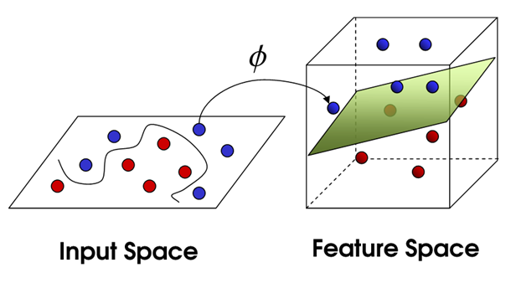
Non-linear SVM

Slide 44
L1-L2 SVM Non-Linear Kernel
Primal Formulation
Kernel methods
Dual

Slide 45
Instead of Kernel methods
Go for Explicit Mapping.
Map to higher dimension using Random Matrix
Learn the theory later.

Slide 46
Random Kitchen sink algorithm
Step-2
Random matrix from N(0,1)
Step-1
Fast Food

Slide 47
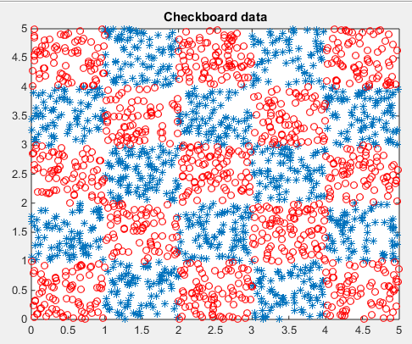
Checkboard data generation
Decision tree
Random Forest
clc;clear all;close all;
x = rand(2000,1)*5;
y = rand(2000,1)*5;
c = mod((floor(x)+floor(y)),2);
ind = find(c);
a = [x(ind),y(ind)];
ind1 = find(c==0);
b = [x(ind1),y(ind1)];
figure(1)
plot(a(:,1),a(:,2),'*');hold on
plot(b(:,1),b(:,2),'o','Color','red');hold off;title('Checkboard data')

Slide 48
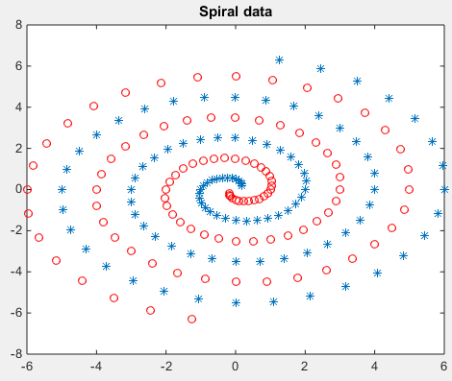
Spiral data generation
x1 = [];y1 = [];
j = 1:100;
angle = j*pi/16;
radius = 6.5*(104-j)/104;
x = radius.*sin(angle);
y = radius.*cos(angle);
x1 = [x1;x]; y1 = [y1;y];
x2 = -x1;y2 = -y1;
figure(2)
plot(x1,y1,’*’);hold on;
plot(x2,y2,’o’,'Color','red');title('Spiral data')

Slide 49
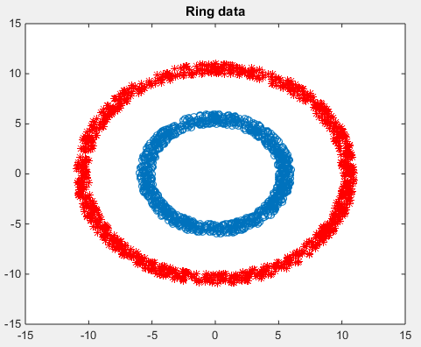
Ring data generation
d = 1000;
r1 = 5+rand(d,1);
theta = 2*pi*rand(d,1);
x1 = r1.*cos(theta);
y1 = r1.*sin(theta);
r2 = 10+rand(d,1);
x2 = r2.*cos(theta);
y2 = r2.*sin(theta);
figure(3)
plot(x1,y1,'o');hold on;
plot(x2,y2,'*','Color','red');title('Ring data')

Slide 50
L1 SVM - Non linear kernel (Primal) – RKS
Checker board data
dim = 700;
[A,d] = data_gen(dim); % checker board data generation
D = diag(d); % diagonal matrix
% RKS
dim = 45;
rng(2545);
R = 2*randn(2,dim);
data = A*R;
data_RKS = [cos(data) sin(data)]; % RKS mapped data
n = size(data_RKS,2);
m = size(data_RKS,1);
e = ones(m,1);

Slide 51
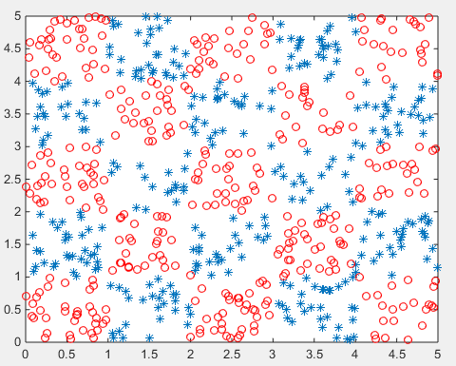
L1 SVM - Non linear kernel (Primal) – RKS Checker board data
%% Non Linear SVM Primal form
c = 10000;
cvx_begin
variables w(n) g Psi(m)
minimize ((0.5*w'*w)+(c*sum(Psi)))
subject to
D*(data_RKS*w-g*e)+Psi-e >= 0;
Psi >= 0;
cvx_end
%% accuracy
z = sign(data_RKS*w-g);
r = sum(d==z);
Acc = (r/m)*100

Slide 52
https://archive.ics.uci.edu/ml/datasets/breast+cancer+wisconsin+(diagnostic)

Slide 53



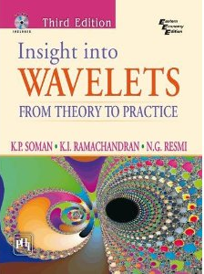
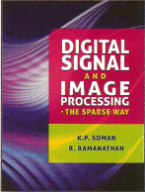

Slide 54
Kernel Method
To solve this without explicit mapping
You need to find Dual of the problem
Learn it later

Slide 55
Loading ARFF file into Matlab
https://in.mathworks.com/matlabcentral/answers/110497-how-to-read-arff-file-in-matlab
Download, unzip and set path

Slide 56
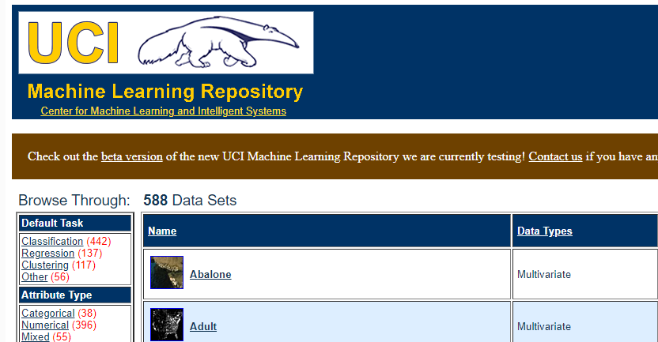
Data Sets for Pattern Classification
https://archive.ics.uci.edu/ml/datasets.php

Slide 57
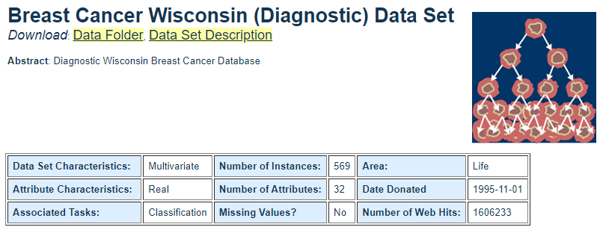
Download Breast Cancer data set
For classification using SVM/LP
https://archive.ics.uci.edu/ml/datasets/breast+cancer+wisconsin+(diagnostic)

Slide 58
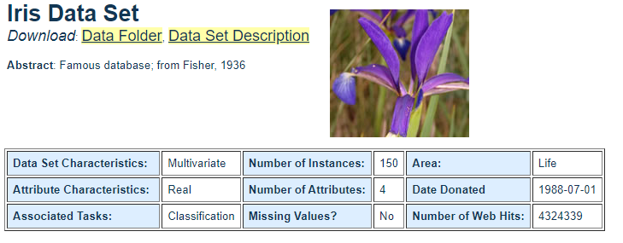
Download Iris data set
For classification using SVM/LP

